Slide 1
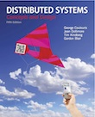
Slides for Chapter 1
Characterization of Distributed Systems
From Coulouris, Dollimore, Kindberg and Blair
Distributed Systems:
Concepts and Design
Edition 5, © Addison-Wesley 2012

Slide 2
Figure 1.1 (see book for the full text)
Selected application domains and associated networked applications
Finance and commerce | eCommerce e.g. Amazon and eBay, PayPal, online banking and trading
The information society | Web information and search engines, ebooks, Wikipedia; social networking: Facebook and MySpace.
Creative industries and entertainment | online gaming, music and film in the home, user-generated content, e.g. YouTube, Flickr
Healthcare | health informatics, on online patient records, monitoring patients
Education | e-learning, virtual learning environments; distance learning
Transport and logistics | GPS in route finding systems, map services: Google Maps, Google Earth
Science | The Grid as an enabling technology for collaboration between scientists
Environmental management | sensor technology to monitor earthquakes, floods or tsunamis
Instructor’s Guide for Coulouris, Dollimore, Kindberg and Blair, Distributed Systems: Concepts and Design Edn. 5
© Pearson Education 2012

Slide 3
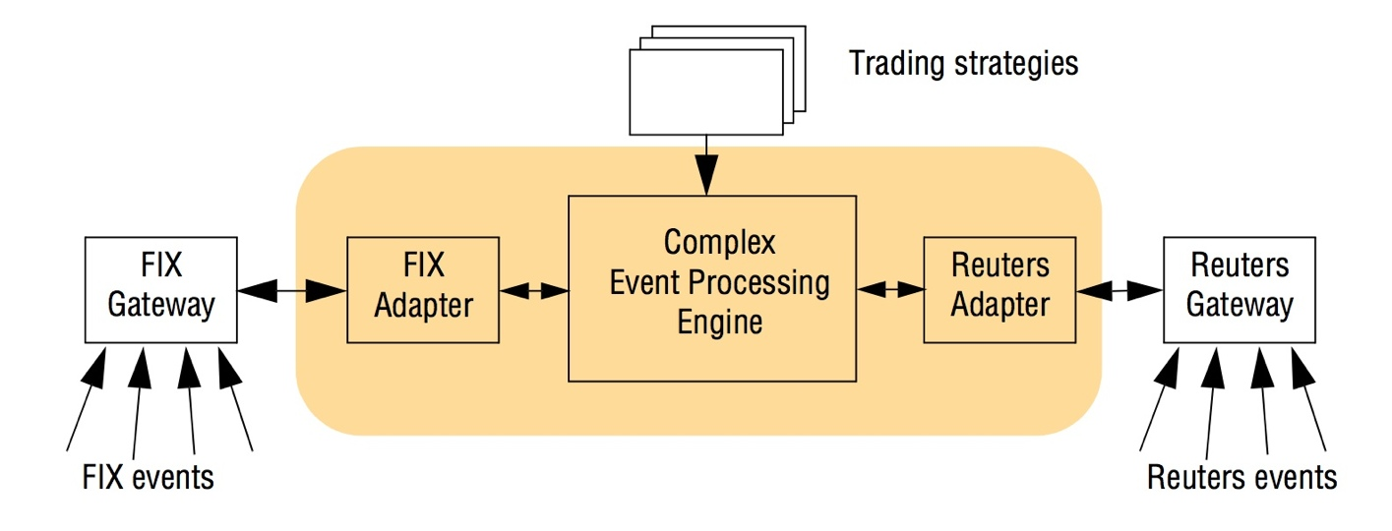
Figure 1.2
An example financial trading system
Instructor’s Guide for Coulouris, Dollimore, Kindberg and Blair, Distributed Systems: Concepts and Design Edn. 5
© Pearson Education 2012

Slide 4
Figure 1.3
A typical portion of the Internet
intranet
☎
ISP
☎
☎
☎
backbone
satellite link
desktop computer:
server:
network link:
Instructor’s Guide for Coulouris, Dollimore, Kindberg and Blair, Distributed Systems: Concepts and Design Edn. 5
© Pearson Education 2012

Slide 5
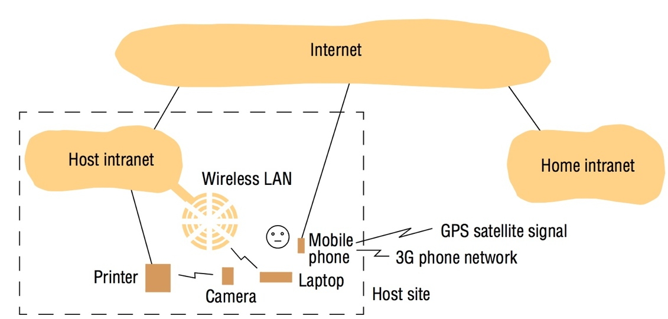
Figure 1.4
Portable and handheld devices in a distributed system
Instructor’s Guide for Coulouris, Dollimore, Kindberg and Blair, Distributed Systems: Concepts and Design Edn. 5
© Pearson Education 2012

Slide 6
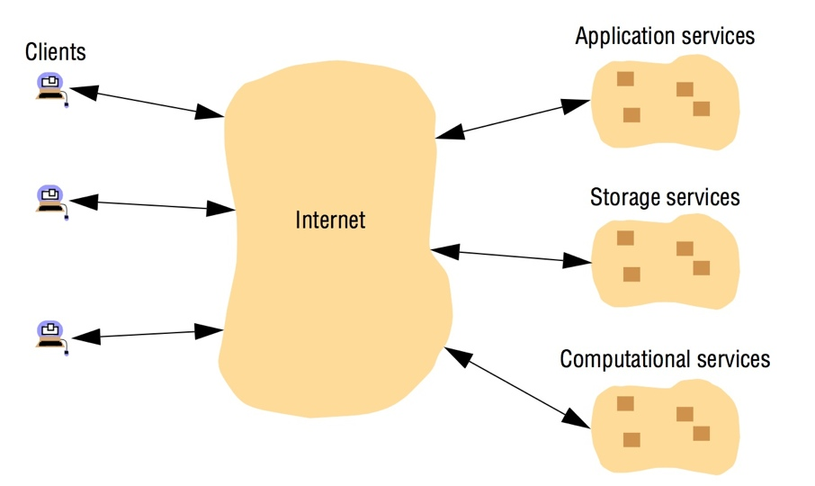
Figure 1.5
Cloud computing
Instructor’s Guide for Coulouris, Dollimore, Kindberg and Blair, Distributed Systems: Concepts and Design Edn. 5
© Pearson Education 2012

Slide 7
Figure 1.6
Growth of the Internet (computers and web servers)
Date
Computers
Web servers
Percentage
1993, July
1,776,000
130
0.008
1995, July
6,642,000
23,500
0.4
1997, July
19,540,000
1,203,096
6
1999, July
56,218,000
6,598,697
12
2001, July
125,888,197
31,299,592
25
2003, July
~200,000,000
42,298,371
21
2005, July
353,284,187
67,571,581
19
Instructor’s Guide for Coulouris, Dollimore, Kindberg and Blair, Distributed Systems: Concepts and Design Edn. 5
© Pearson Education 2012

Slide 8
Section 1.5.7
Transparencies
Access transparency: enables local and remote resources to be accessed using identical
operations.
Location transparency: enables resources to be accessed without knowledge of their physical
or network location (for example, which building or IP address).
Concurrency transparency: enables several processes to operate concurrently using shared
resources without interference between them.
Replication transparency: enables multiple instances of resources to be used to increase
reliability and performance without knowledge of the replicas by users or application
programmers.
Failure transparency: enables the concealment of faults, allowing users and application
programs to complete their tasks despite the failure of hardware or software components.
Mobility transparency: allows the movement of resources and clients within a system
without affecting the operation of users or programs.
Performance transparency: allows the system to be reconfigured to improve performance
as loads vary.
Scaling transparency: allows the system and applications to expand in scale without change
to the system structure or the application algorithms.
Instructor’s Guide for Coulouris, Dollimore, Kindberg and Blair, Distributed Systems: Concepts and Design Edn. 5
© Pearson Education 2012

Slide 9
Figure 1.7
Web servers and web browsers
Web servers
Browsers
http://www.google.comlsearch?q=obama
www.google.com
www.cdk5.net
Internet
http://www.cdk5.net/
www.w3c.org
File system of
http://www.w3.org/standards/faq.html#conformance
www.w3c.org
standards
faq.html
Instructor’s Guide for Coulouris, Dollimore, Kindberg and Blair, Distributed Systems: Concepts and Design Edn. 5
© Pearson Education 2012

